Slide 1
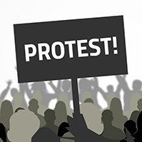
Understanding the History of Protest
What it means
Where it began
Historical Context

Slide 2
In this module we will learn
A History of Protest
What protest is
How it started
Where it began
Historical Context

Slide 3
Context
Struggling against the powerful is a tradition that stretches back generations.
Change is often presented as a gift granted by the powerful, but it has much to do with the struggle and sacrifice of those from below.
From wealthy barons taking on an arbitrary king to the demands of the 99% today, protest has changed the world. It is as powerful a weapon of change as it has ever been.

Slide 4
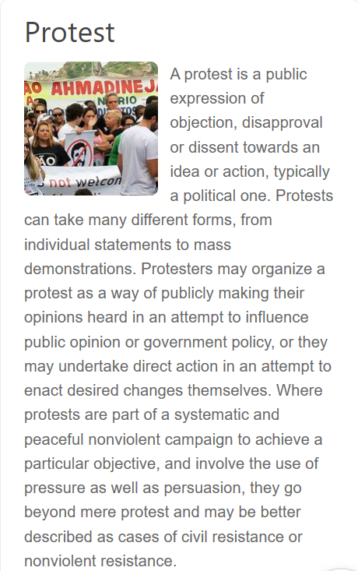
Protest is defined as:

Slide 5
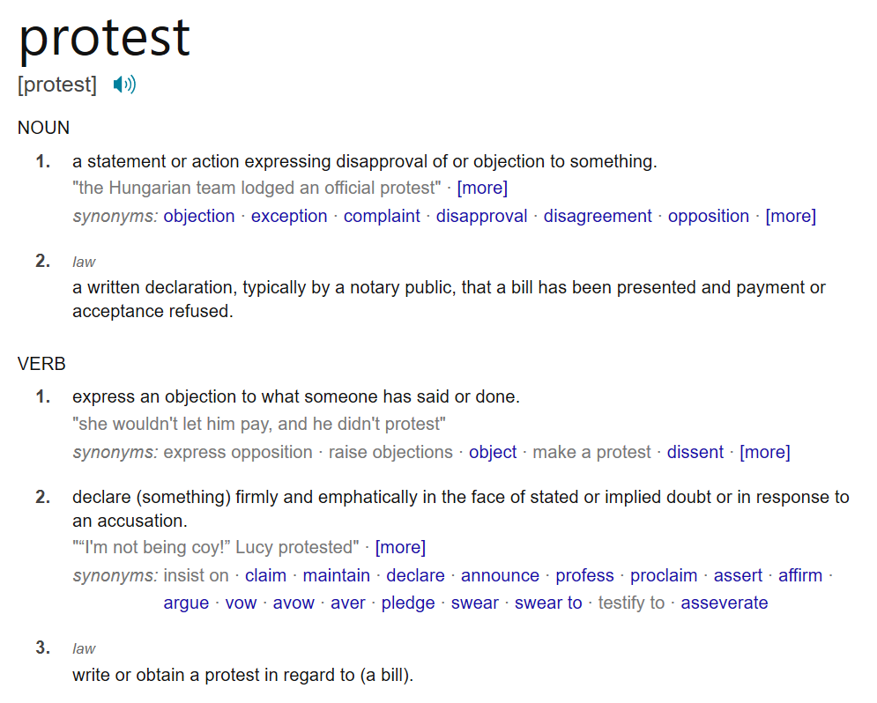
Protest can be used as a noun or a verb.

Slide 6
Activity 1A:
Visit the following website: https://www.bbc.co.uk/teach/the-people-are-revolting-the-history-of-protest/zdpdgwx
Select two videos and time periods. Read the description and watch the videos.
Complete the reflection activity.

Slide 7
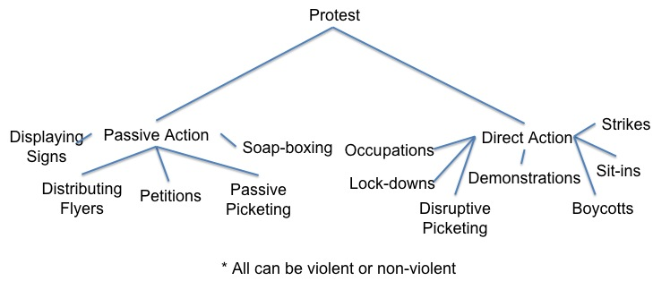
Protests can take place in many different formats.

Slide 8
Discussion Board:
Which type of protest do you think is most impactful?

Slide 9
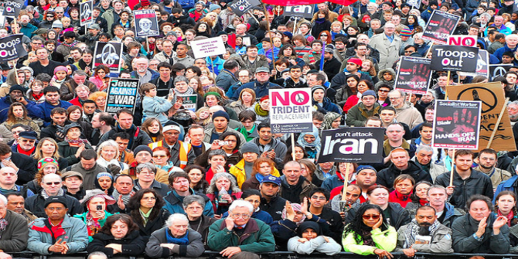
Activity 1B:
Find an example of a protest that occurred between 2018 and 2020.
Complete a journal reflection answering the following:
Type of protest
Date, location
Organizers
Impact
Pros and cons
The outcome or impact
Supporting details
This Photo by Unknown Author is licensed under CC BY-NC-ND

Slide 10
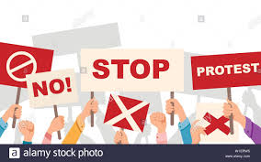
Activity 1C
Visit the website below:
https://www.theodysseyonline.com/protests-that-changed-history#:~:text=1%20Boston%20Tea%20Party%2C%201773.%20The%20Boston%20Tea,Movement%20was%20to%20end%20slavery%20and%20racial%20discrimination
2. Read about the examples of protests throughout history.
3. Select one of the examples and submit a sample summary of the event, as though you were there in history.

